Slide 1

ANT , MAVEN AND JUNIT FUNDAMENTALS
Shreshtt Bhatt Oct 12, 2021
INTERNAL

Slide 2
Agenda
Build Tools
Why we need Build Tools
Ant
Introduction
Terminology & Concepts
Examples
References
Maven
Introduction
Main Features
Build Life Cycle
Maven vs Ant
Examples
References
JUnit 5
Introduction
Architecture
Examples
Annotations
Assertions
Assumptions
References
© 2020 SAP SE or an SAP affiliate company. All rights reserved. ǀ INTERNAL
2

Slide 3
Build Tools

Slide 4
What is Build Tools?
Build automation is the process of automating the creation of a software build and the associated processes including: compiling computer source code into binary code, packaging binary code, and running automated tests.
Build automation makes the process repeatable.

Slide 5
Why we need Build Tools?
Day-to-Day activities in Most of Software Development
Downloading dependencies.
Compiling source code into binary code.
Packaging that binary code.
Running tests.
Deployment to production systems.
Build Tools help to
automate these tasks
Benefits
Automates the drudge work and makes developer productive
Manage dependencies
Ensures correct execution order of commands
Saves time by parallelizing different tasks
A precondition for continuous integration

Slide 6

Apache Ant

Slide 7
Introduction
ANT stands for Another Neat Tool.
Ant is a Java based tool for automating the build process such as compile, package, test and deploy.
Ant is Open Source, maintained by Apache (released on 19 July 2000).
Apache ANT’s build files are written in XML.
Ant is cross platform and portable. Faster since each command is executed within JVM
One-time setup hassle provides easy building of a project

Slide 8
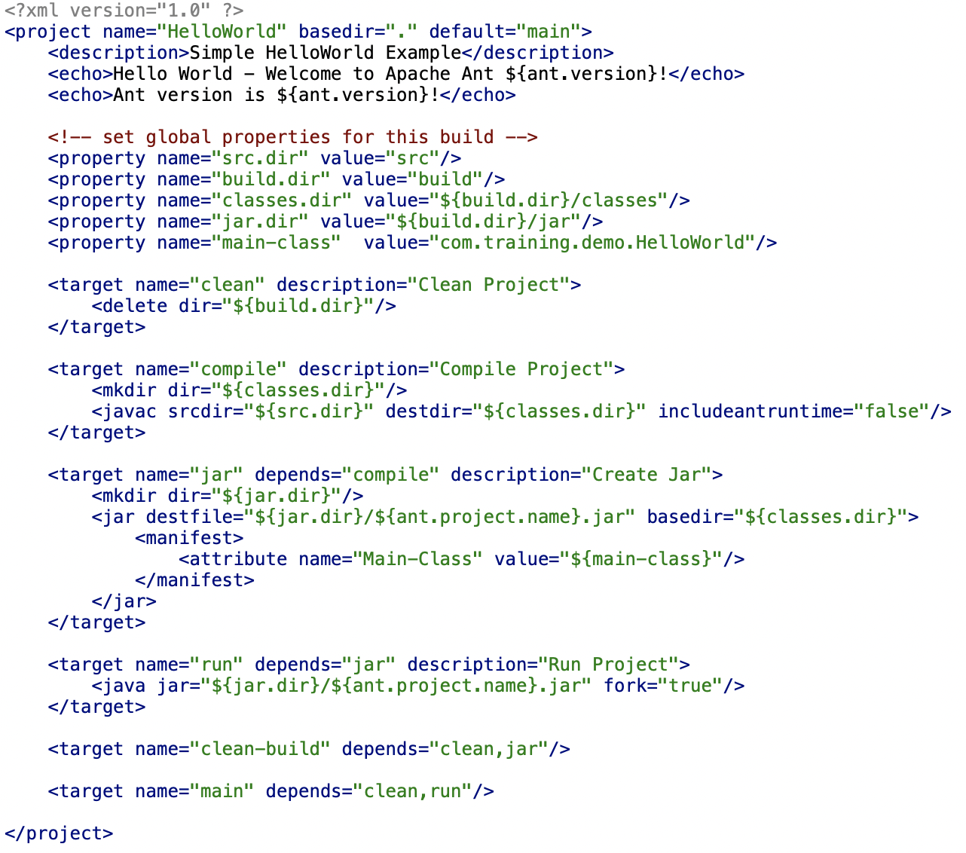
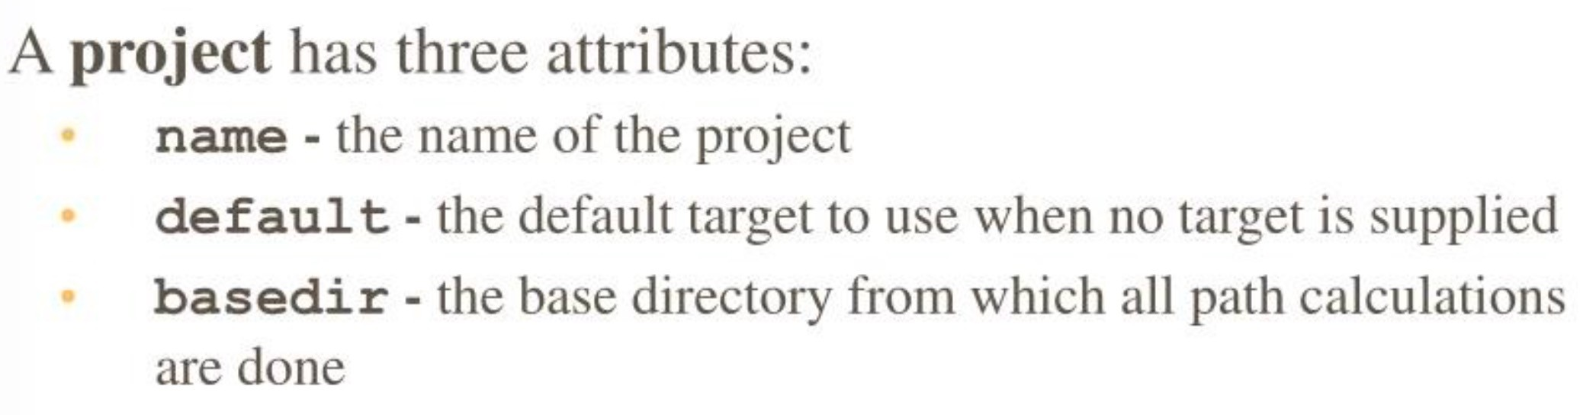
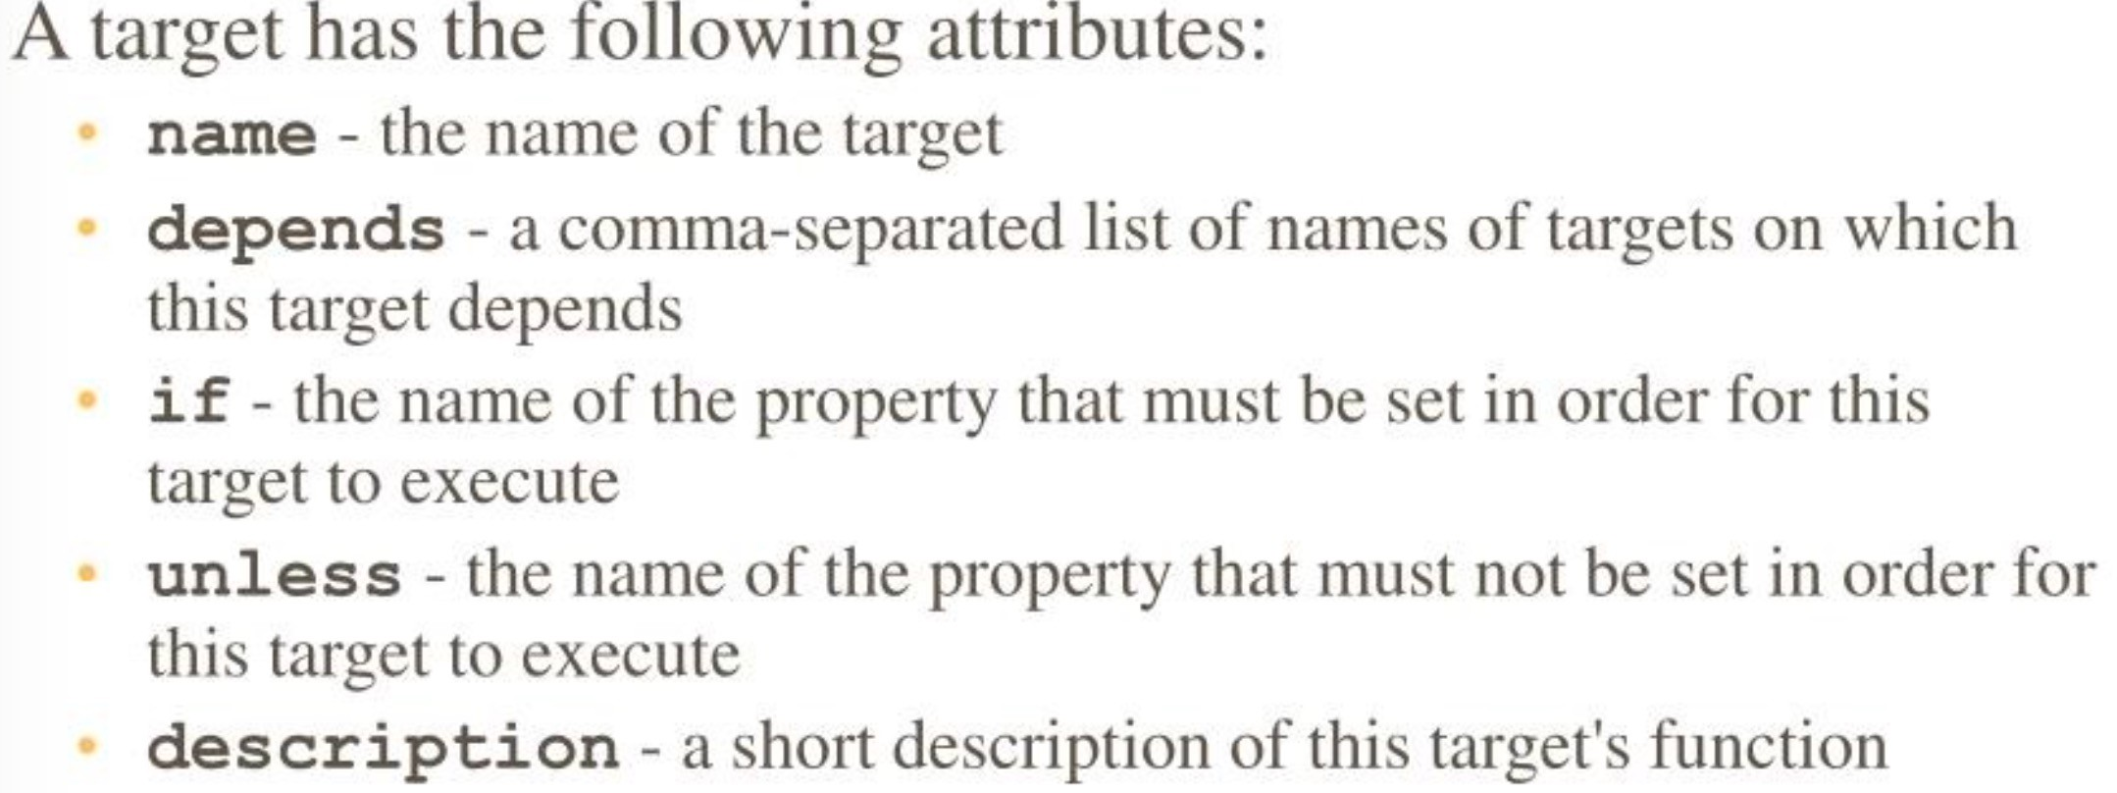
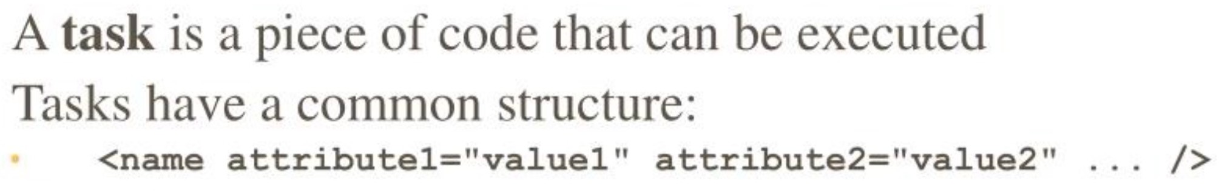
Example 1 - build.xml

Slide 9
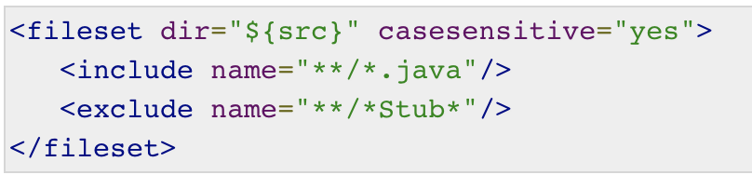
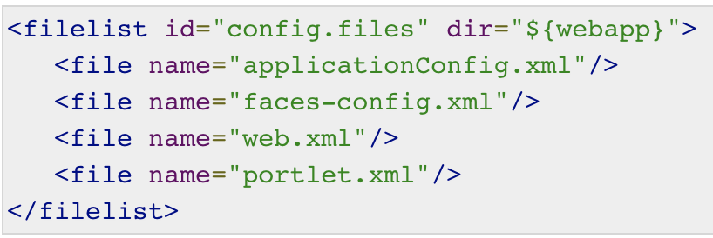
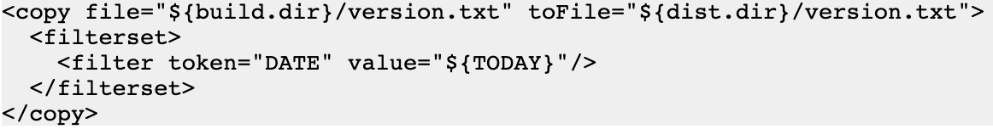
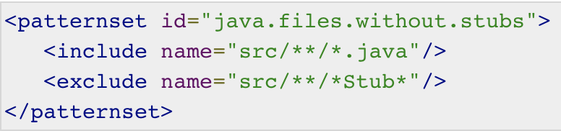
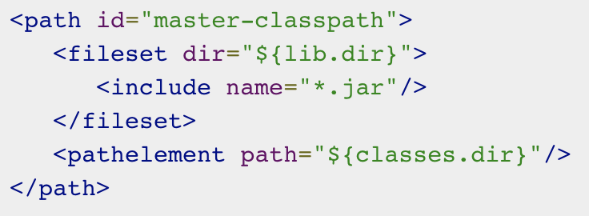
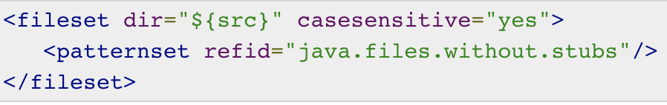
Data Types
Fileset - It is used as a filter to include or exclude files that match a particular pattern.
File list - similar to the file set but it does not support wild cards.
Filter set – Used to replace certain text in files matches the pattern with a replacement value. Check here
Pattern set - A pattern set is a pattern that
allows to filter files or folders easily based
on certain patterns.
Path - The path data type is commonly used
to represent a class-path.

Slide 10
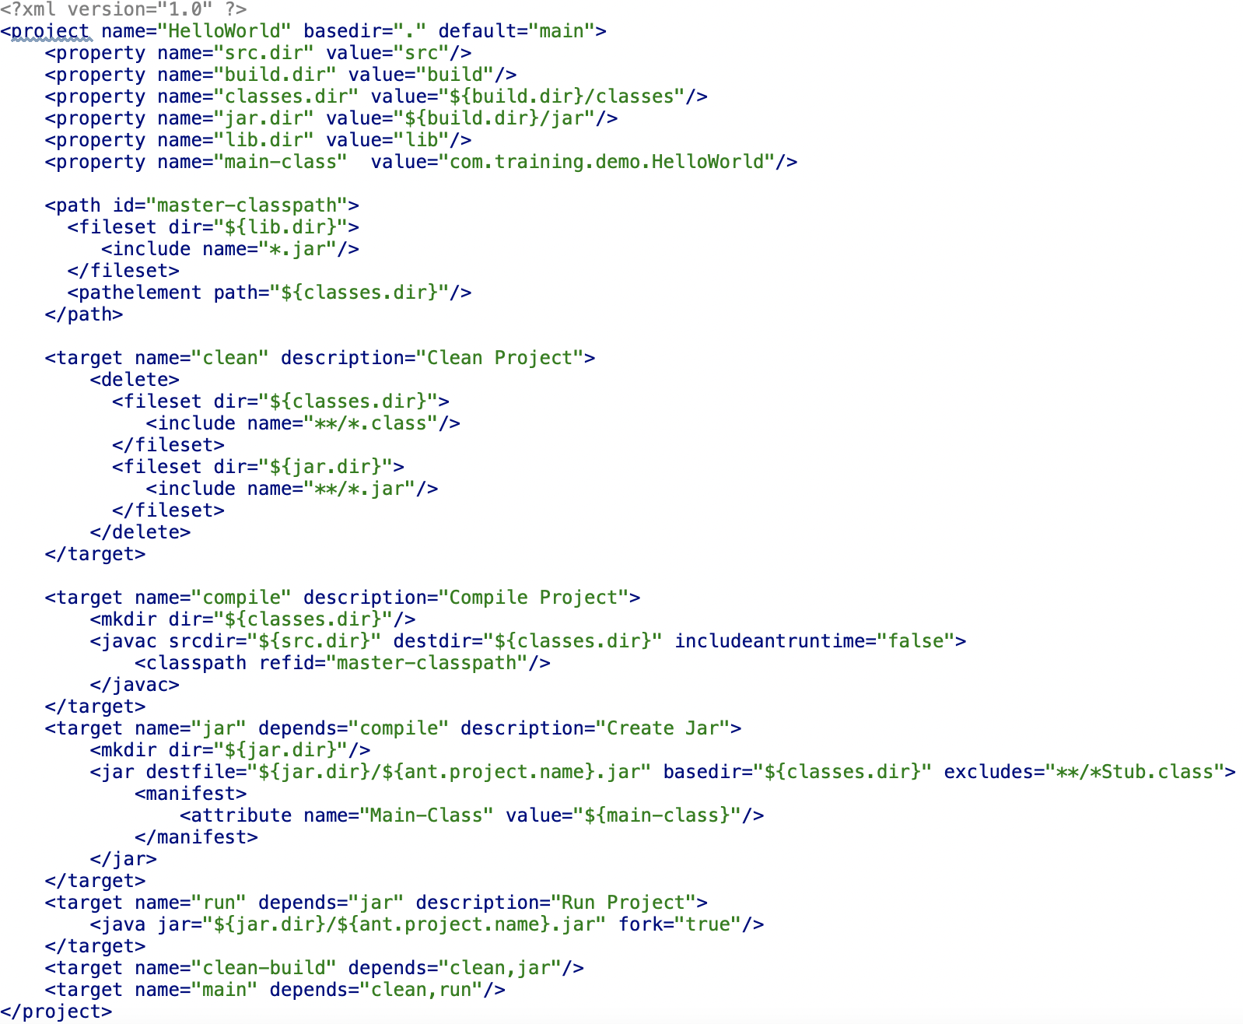
Example 2 - build.xml

Slide 11
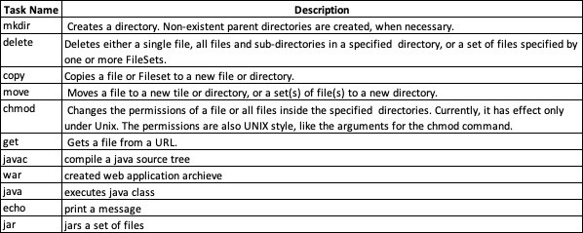
build.xml : List Of Tasks

Slide 12
Ant - References
Apache Ant Fundamentals :
https://ant.apache.org/
https://app.pluralsight.com/library/courses/apache-ant-fundamentals/table-of- contents?aid=7010a000002BWq6AAG
Complete List of Tasks :
https://ant.apache.org/manual/tasksoverview.html
https://ant.apache.org/manual/Tasks/
Ant Manual :
http://ant.apache.org/manual/index.html

Slide 13

Apache Maven

Slide 14
Introduction
Maven is a project management and comprehension tool that provides developers a complete build lifecycle framework. Using maven we can build and manage any Java based project.
Based on the concept of a project object model (POM), Maven can manage a project's build, documentation, reporting, dependencies, releases and distribution from a central piece of information.
A Project Object Model or POM is the fundamental unit of work in Maven. It is an XML file (pom.xml) that contains information about the project and configuration details used by Maven to build the project.
Maven uses Convention over Configuration, which means developers are not required to create build process themselves.
Maven is actually a plugin execution framework where every task is actually done by plugins.

Slide 15
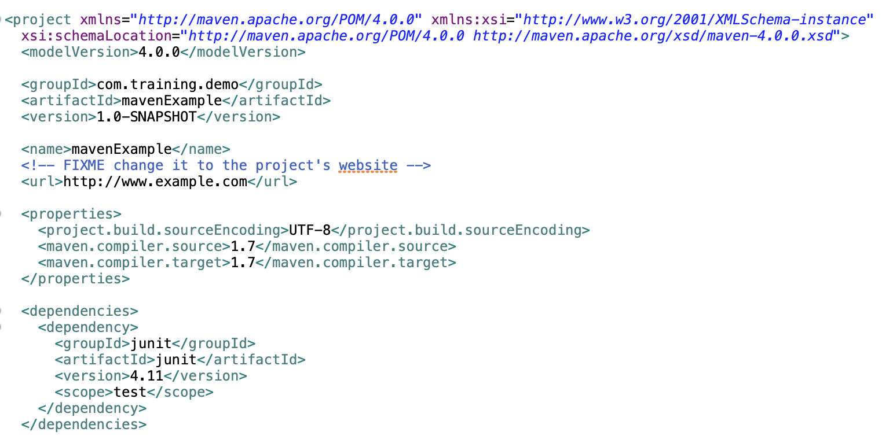
Project Object Model (POM)
Super POM
The Super POM is Maven’s default POM. All POMs inherit from a parent or default (despite explicitly defined or not). This base POM is known as the Super POM, and contains values inherited by default.
mvn help:effective-pom

Slide 16
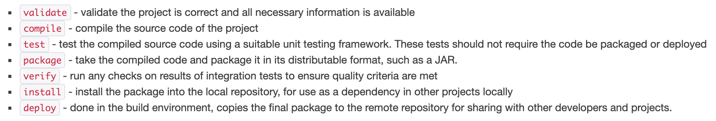
Build Lifecycle
A Build Lifecycle is a well-defined sequence of phases, which define the order in which the goals are to be executed.
Maven has the following three standard lifecycles −
Clean - handles project cleaning
Default - handles project deployment
Site - handles the creation of project's web site
Phases
Each of these build lifecycles is defined by a different list of build phases, wherein a build phase represents a stage in the lifecycle. For example, the default lifecycle comprises of the following phases (for a complete list of the lifecycle phases, refer to the Lifecycle Reference):

Slide 17
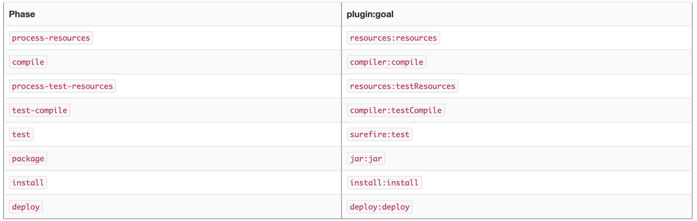
Goals
A goal represents a specific task which contributes to the building and managing of a project. It may be bound to zero or more build phases. A goal not bound to any build phase could be executed outside of the build lifecycle by direct invocation.
mvn clean dependency:copy-dependencies package
Packaging – Each packaging contains a list of goals to bind to a particular phase. Some of the valid packaging values are jar, war, ear and pom. If no packaging value has been specified, it will default to jar.
Jar
Package
Example
Full List

Slide 18
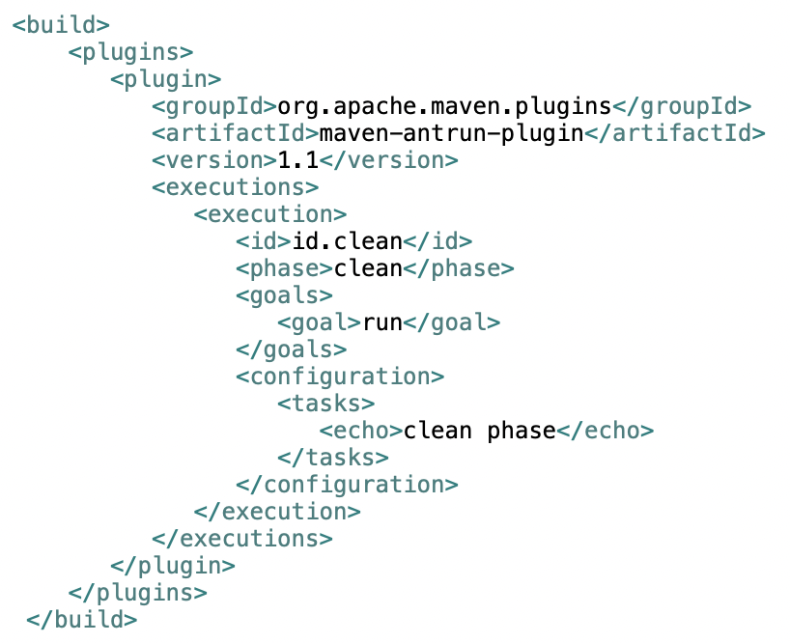
Plugins
Plugins are artifacts that provide goals to Maven. A plugin may have one or more goals wherein each goal represents a capability of that plugin. For example, the Compiler plugin has two goals: compile and testCompile.
mvn [plugin-name]:[goal-name]
Maven provided the following two types of Plugins −
Build plugins - They execute during the build process and should be configured in the <build/> element of pom.xml.
Reporting plugins - They execute during the site generation process and they should be configured in the <reporting/> element of the pom.xml.
Available Plugins

Slide 19
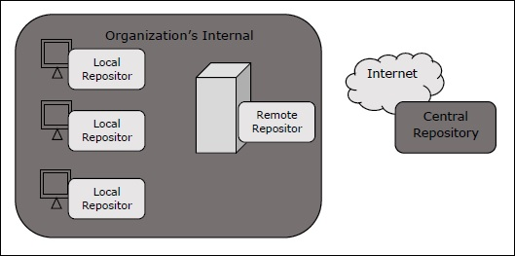
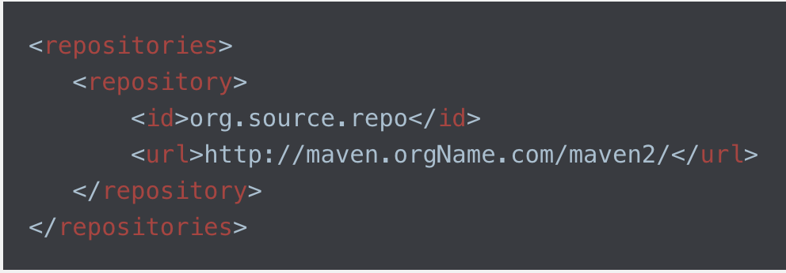
Maven Repository
In Maven terminology, a repository is a directory where all the project jars, library jar, plugins or any other project specific artifacts are stored and can be used by Maven easily. Maven repository are of three types –
Local - Maven local repository is a folder location on your machine (%USER_HOME%/.m2). It gets created when you run any maven command for the first time.
Central - Maven central repository is repository provided by Maven community. It contains a large number of commonly used libraries (https://repo1.maven.org/maven2/).
Remote – Maven will use this when It doesn’t find dependency in local and central repository.
Remote Repository Example

Slide 20
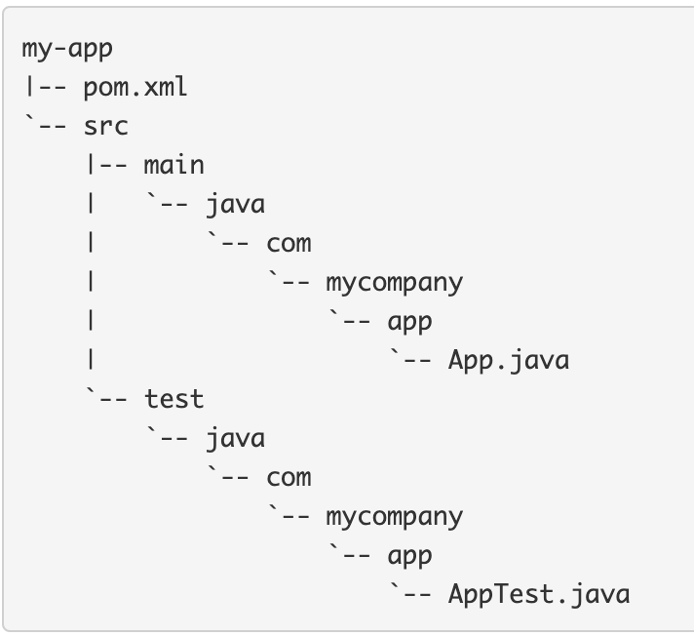
Create Project
Maven uses archetype plugins to create projects. To create a simple java application, we'll use maven-archetype-quickstart plugin.
mvn archetype:generate -DgroupId=com.mycompany.app -DartifactId=my-app -DarchetypeArtifactId=maven-archetype-quickstart -DarchetypeVersion=1.4 -DinteractiveMode=false
The src/main/java directory contains the project source code
The src/test/java directory contains the test source, and
The pom.xml file is the project's Project Object Model, or POM.
maven-archetype-quickstart

Slide 21
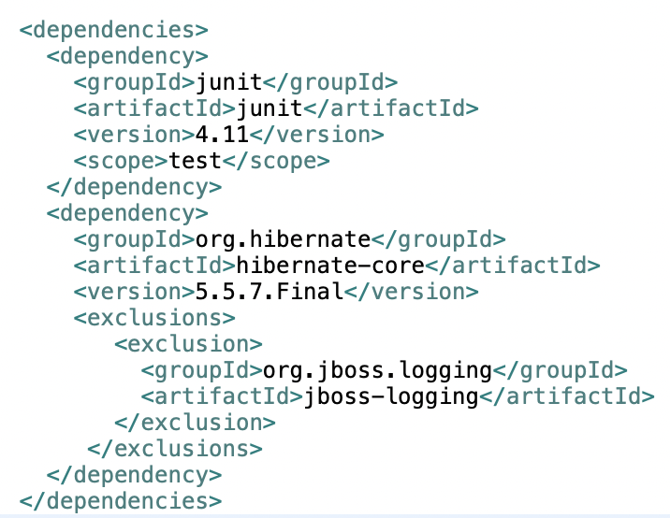
Dependency Mechanism
Dependency management is a core feature of Maven. With transitive dependencies, We only need to define direct dependency in each project pom. Maven handles the rest automatically.
Maven provides few features to control extent of transitive dependencies.
Dependency mediation
Dependency management
Dependency scope
Excluded dependencies
Optional dependencies
For more details check here & here.

Slide 22
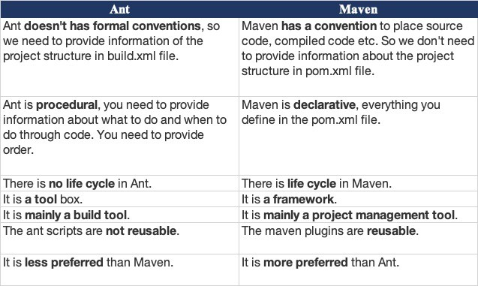
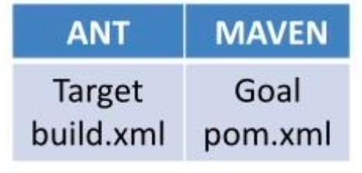
Difference between Ant and Maven
Ant and Maven both are build tools provided by Apache. The main purpose of these technologies is to ease the build process of a project.

Slide 23
Maven - References
Apache Maven Fundamentals :
https://maven.apache.org/index.html
https://app.pluralsight.com/course-player?clipId=53514f71-2af5-4287-96cc- 1a0b35690db1
Maven :
https://sap.plateau.com/learning/user/deeplink.do?OWASP_CSRFTOKEN=YY9U-ESKR- WR3Q-BSIY-OCPN-BSJO-OE8Q-
1TYU&linkId=ITEM_DETAILS&componentID=LINKEDINLEARNING_47957&componentTypeID
=COURSE&fromSF=Y&revisionDate=1581530387000

Slide 24

JUNIT 5

Slide 25
Software Testing
A software test is a piece of software, which executes another piece of software asserting that it behaves in a certain way.
These tests are typically executed automatically via the build system and therefore help the developer to avoid breaking existing code during development activities.
Unit Testing | Integration Testing
Unit testing means testing individual modules of an application in isolation (without any interaction with dependencies) to confirm that the code is doing things right. | Integration testing means checking if different modules are working fine when combined together as a group.
Unit testing is a white box testing. | Integration testing is a black box testing.
Unit test does not verify whether your code works with external dependencies correctly. | Integration tests verify that your code works with external dependencies correctly.
Unit testing is basically performed by the developer. | Integration testing is performed by the tester.

Slide 26
JUNIT5
JUnit is the standard tool for unit testing in java. It is a simple, open-source framework to write and run repeatable tests.
JUnit 5 = JUnit Platform + JUnit Jupiter + JUnit Vintage
JUnit Platform - The JUnit Platform serves as a foundation for launching testing frameworks on the JVM. It defines the TestEngine API for developing new testing frameworks that runs on the platform. It also provides a Console Launcher to launch the platform from the command line and build plugins for Gradle and Maven.
JUnit Jupiter - It includes new programming and extension models for writing tests. It has all new JUnit annotations and TestEngine implementation to run tests written with these annotations.
JUnit Vintage - It primary purpose is to support running JUnit 3 and JUnit 4 written tests on the JUnit 5 platform. It’s there are backward compatibility.

Slide 27
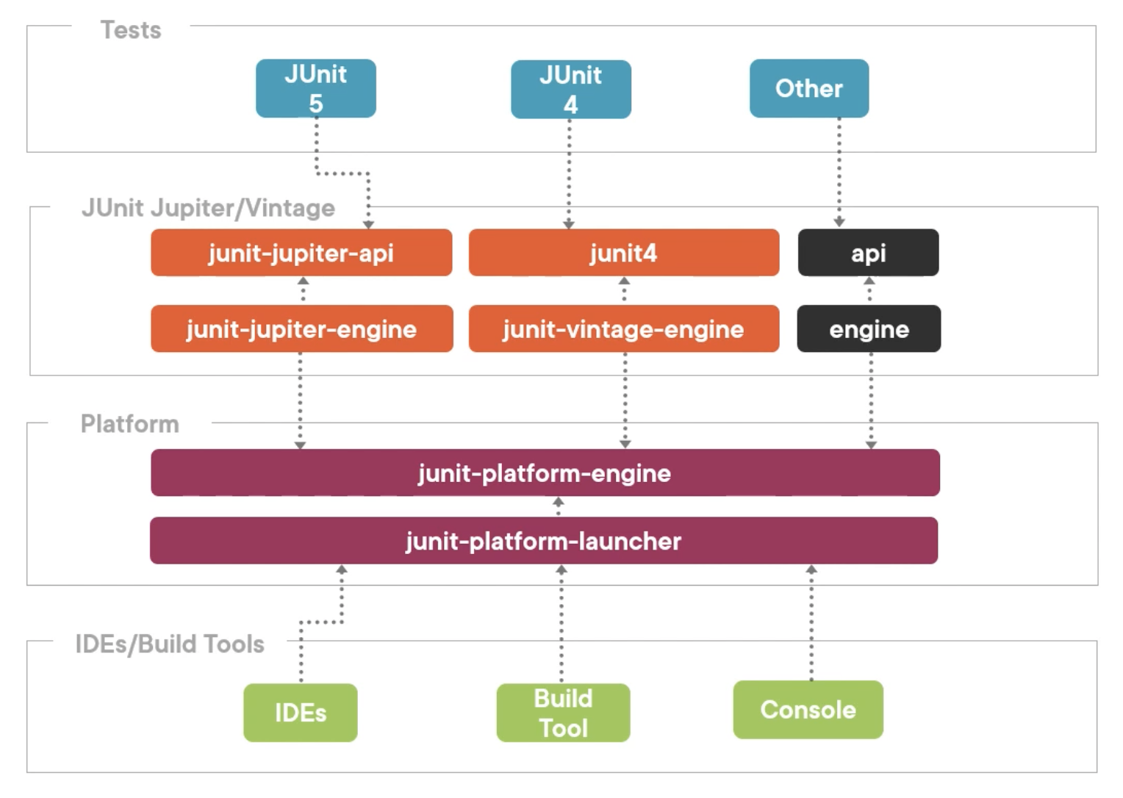
JUNIT5 Architecture

Slide 28
Annotations
Check Full List
Annotation | Description
@Test | Denotes that a method is a test method.
@ParameterizedTest | Parameterized tests make it possible to run a test multiple times with different arguments.
@RepeatedTest | Provides ability to repeat a test a specified number of times
@DisplayName | Used to provide any custom display name for a test class or test method
@BeforeEach | The annotated method will be run before each test method in the test class.
@AfterEach | The annotated method will be run after each test method in the test class.
@BeforeAll | The annotated method will be run before all test methods in the test class. This method must be static.
@AfterAll | The annotated method will be run after all test methods in the test class. This method must be static.
@Nested | Used to create nested test classes
@Tag | Mark test methods or test classes with tags for test discovering and filtering
@Disabled | It is used to disable or ignore a test class or method from test suite.
@TestFactory | Mark a method is a test factory for dynamic tests

Slide 29
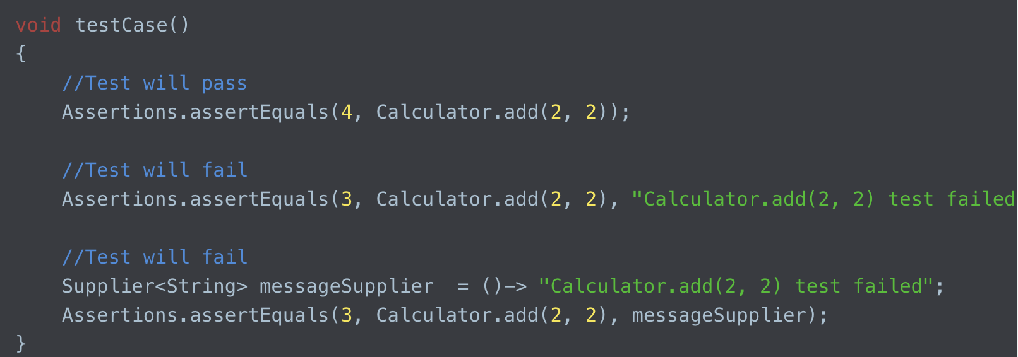
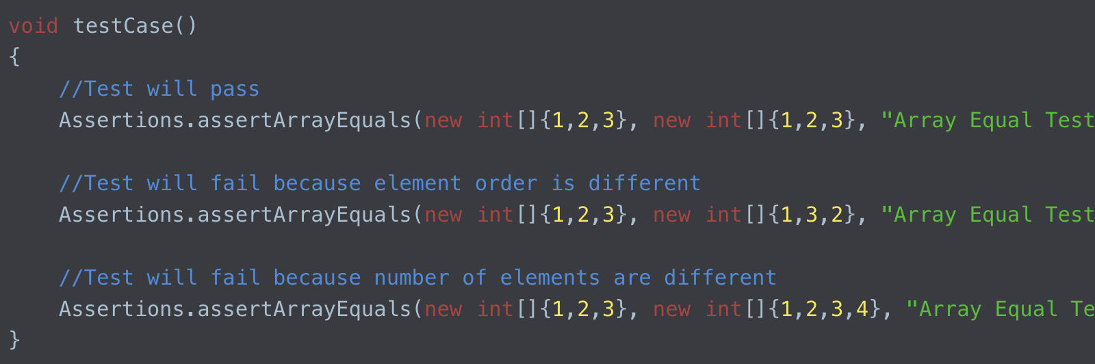
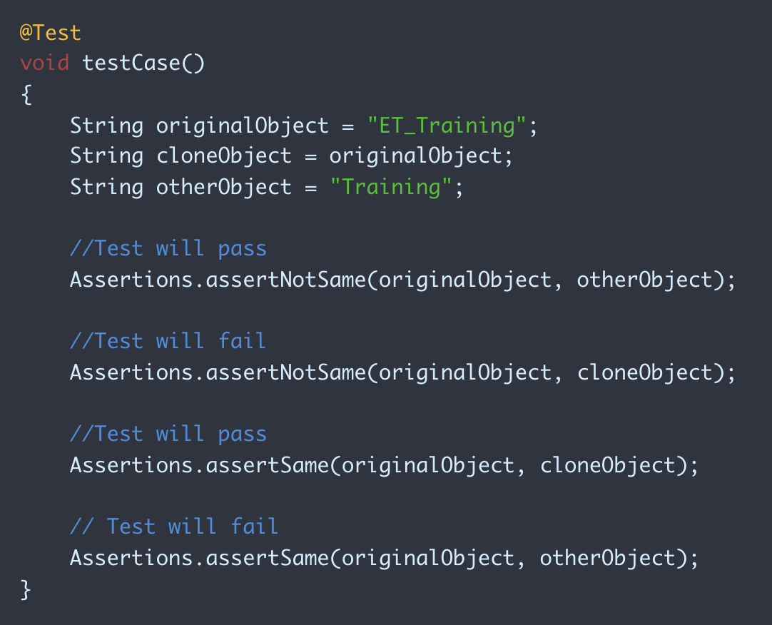
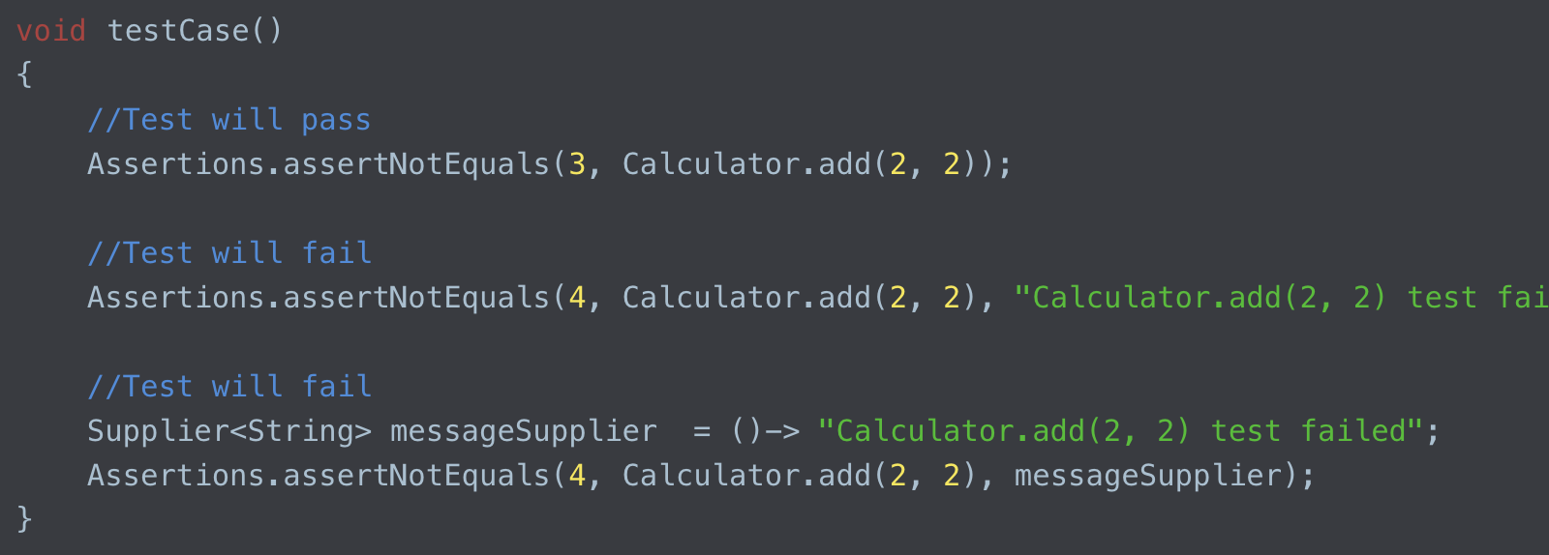
Assertion
JUnit 5 assertions help in validating the expected output with actual output of a testcase. All JUnit Jupiter assertions are static methods in the org.junit.jupiter.api.Assertions class.

Slide 30
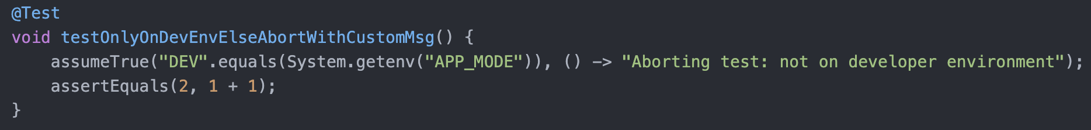
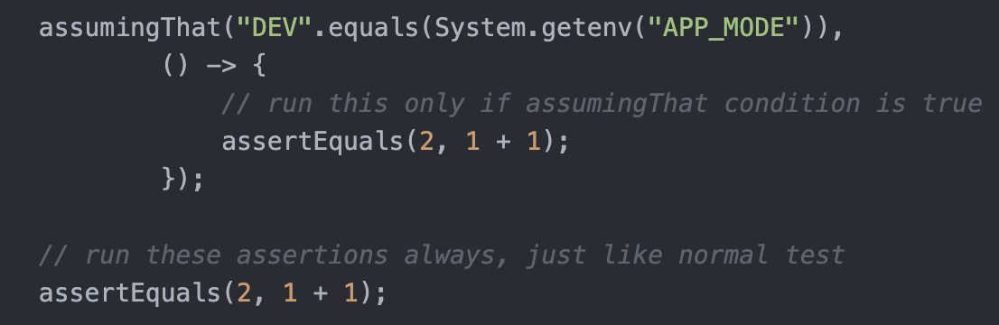
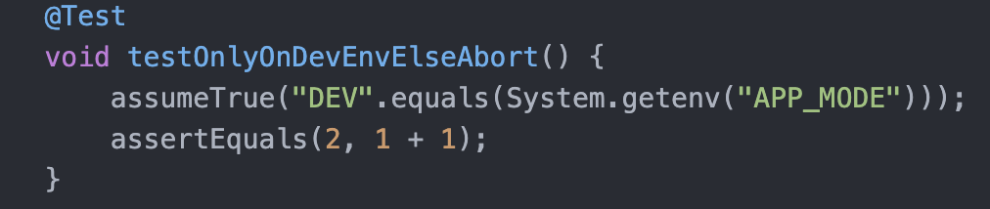
Assumption
JUnit 5 Assumptions class provides static methods to support conditional test execution based on assumptions. A failed assumption results in a test being aborted. JUnit Jupiter Assumptions class has following such methods: assumeFalse(), assumeTrue(), assumingThat​()

Slide 31
References
Junit User Guide : https://junit.org/junit5/docs/current/user-guide/
Junit 5 Assertions Doc : https://junit.org/junit5/docs/5.0.1/api/org/junit/jupiter/api/Assertions.html
Pluralsight Junit5 : https://www.pluralsight.com/courses/junit-5-unit-testing-getting-started
Success Map : testing with JUNIT : https://sap.plateau.com/learning/user/deeplink.do?OWASP_CSRFTOKEN=YY9U-ESKR-WR3Q- BSIY-OCPN-BSJO-OE8Q- 1TYU&linkId=ITEM_DETAILS&componentID=LINKEDINLEARNING_50794&componentTypeID
=COURSE&fromSF=Y&revisionDate=1581532274000
Mockito :
https://app.pluralsight.com/library/courses/mockito-getting-started/table-of-contents
https://javadoc.io/doc/org.mockito/mockito-core/latest/org/mockito/Mockito.html

Slide 32
Contact Information
Shreshtt Bhatt
shreshtt.bhatt@sap.com

Slide 33
Thank you.

